Slide 1

Argument Mapping
BBA 1st SEM (2022-23)
Submitted By-
Shankh Bansal
Submitted To-
Dr. Amber Tiwari

Slide 2
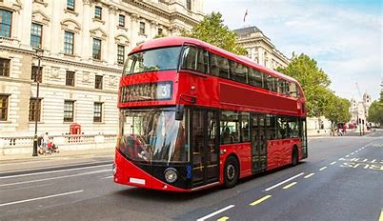
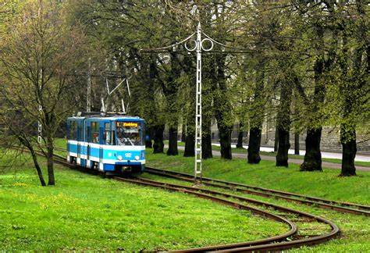




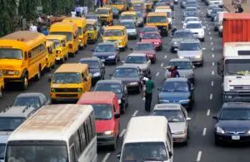




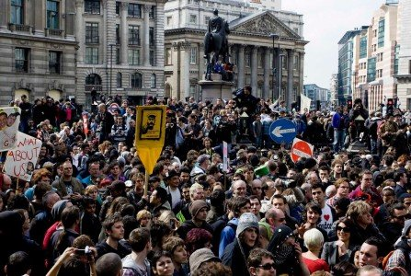
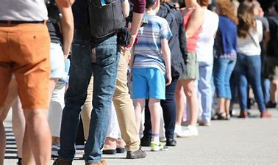
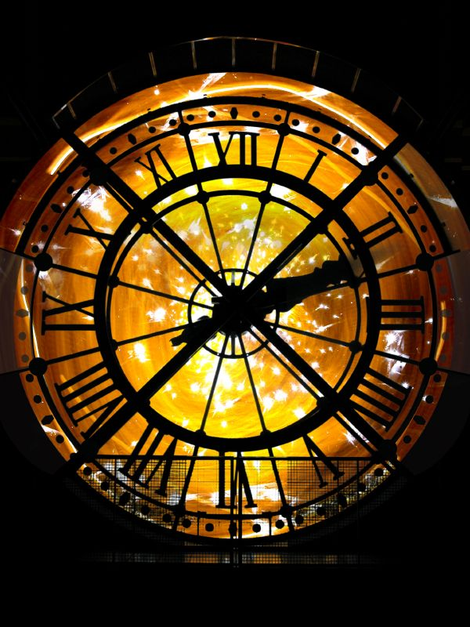




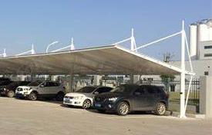


Because
We should use public transport instead of private.
But
However
We should make more use of transport that is good for nature.
Public transport is good for environment
Busses and train reduce pollution
Efficiency must be balanced by sustainability
It charge 4 time less than private transport
It will reduce number of cars on road
It waste time
Lack of comfort
Long waiting time
Long walking time
Its unreliable
Its too crowded
Time uncertainty
We will be relaxed on our journey
We get to interact with people
There will be no need to worry about food
There will be no need to drive
It reduces parking tension
It reduces stress
Its cost effective

Slide 3
Conclusion
To understand logical structure of argument.
Support issue which we think.
(BECAUSE) is represented by green colour.
(BUT) is represented by red colour.
( HOWEVER) is represented by orange colour.

